Slide 1
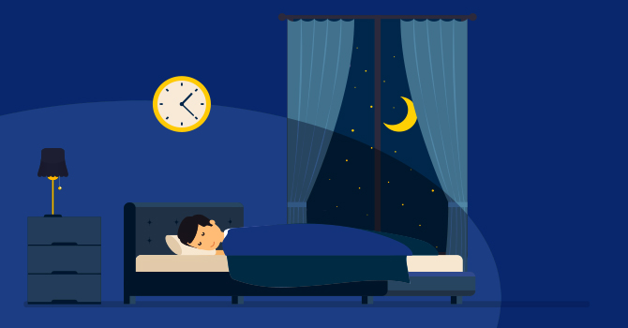
Analysis On University Students Sleeping Patterns
Why this topic?

Slide 2
Analysis On University Students Sleeping Patterns
Why this topic?

Slide 3
Analysis On University Students Sleeping Patterns
Why this topic?
Understanding sleep patterns in university students is essential because it directly impacts academic performance, mental health, and overall well-being. Sleep is crucial for cognitive functioning, memory consolidation, and stress management.
Somay (38027)
Shivam (38040)
Anand
Keshav (38046)
However, university students often face irregular schedules, workload pressures, and social influences that can disrupt healthy sleep. By analyzing sleep patterns, we can identify trends, challenges, and potential interventions to promote better sleep habits, enhancing students' academic outcomes and long-term health.

Slide 4
Tools and Data Info
Python
Jupyter Notebook
Numpy
Pandas
Matplotlib
Seaborn

Slide 5


Tools and Data Info
Platform: Kaggle
Collected By: Arsalan Jamal in 2024
Sample Size: [Number of students]
Data Points Collected: Sleep duration, bedtime, wake-up time, academic workload, and lifestyle habits.
Shape:

Slide 6
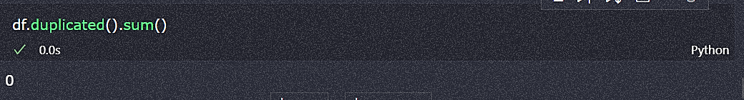
Tools and Data Info

Slide 7
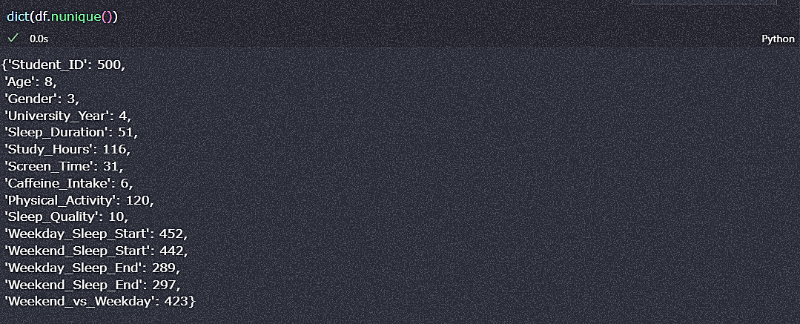
Tools and Data Info

Slide 8
Tools and Data Info

Slide 9
VISUALIZATIONS OF THE DATASET

Slide 10
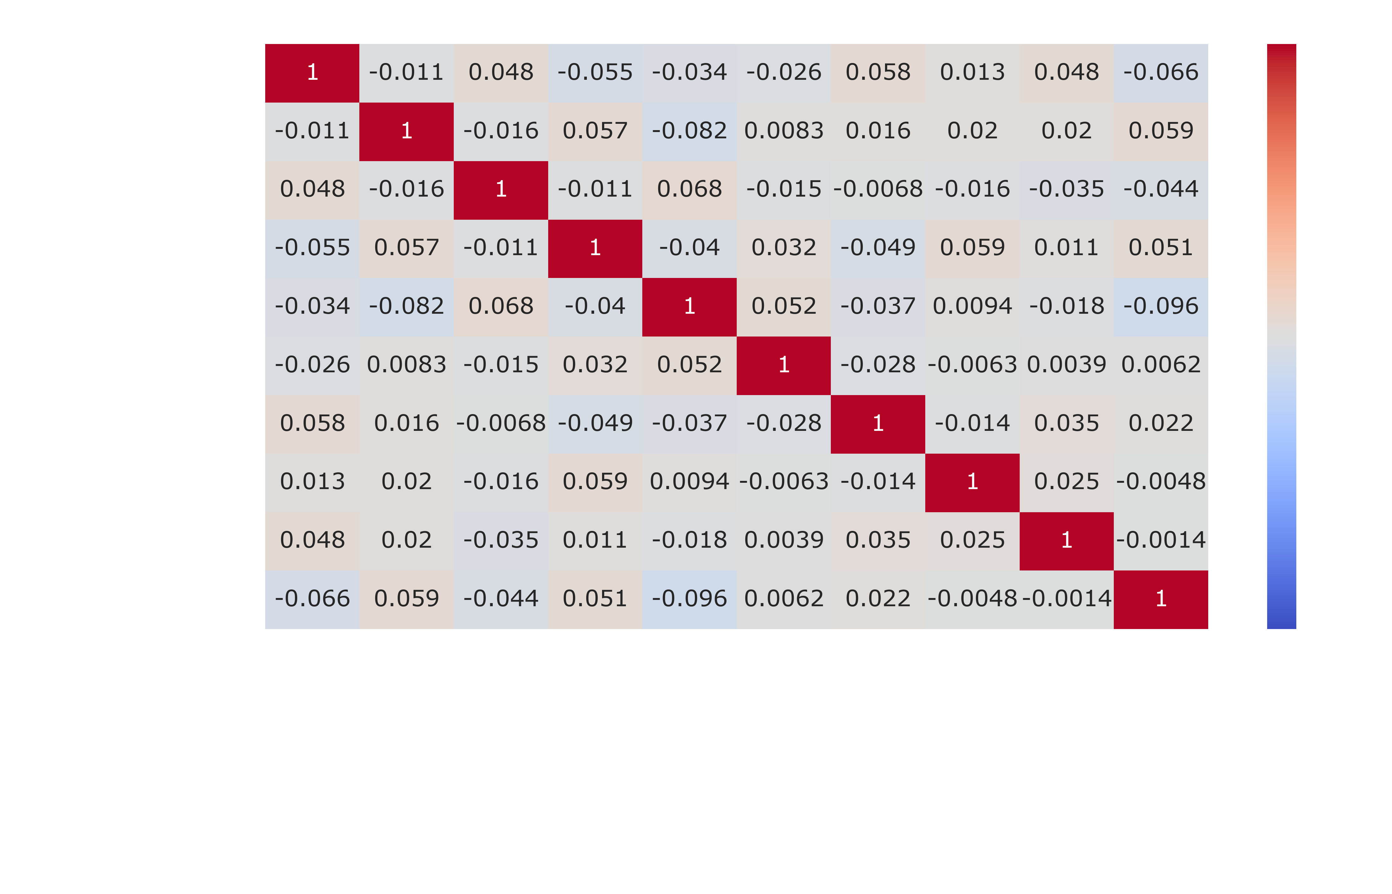
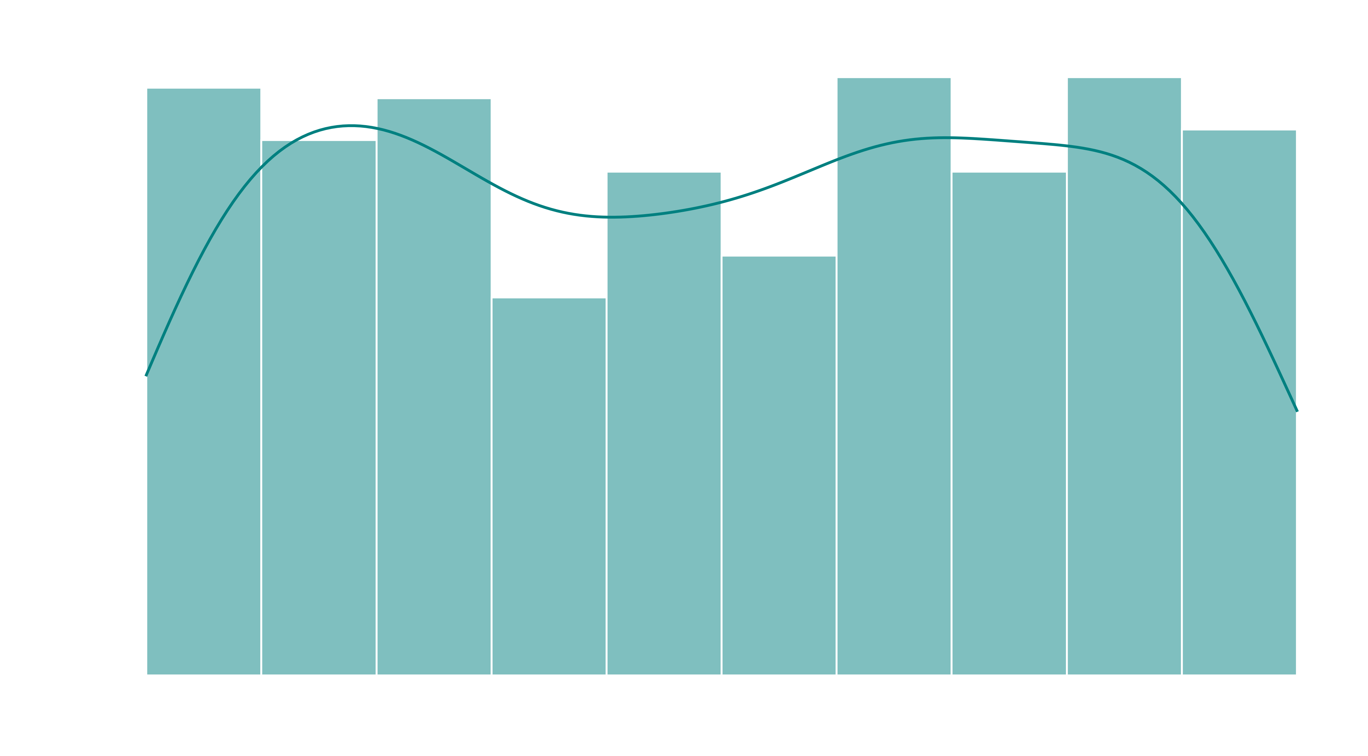
VISUALIZATIONS OF THE DATASET

Slide 11
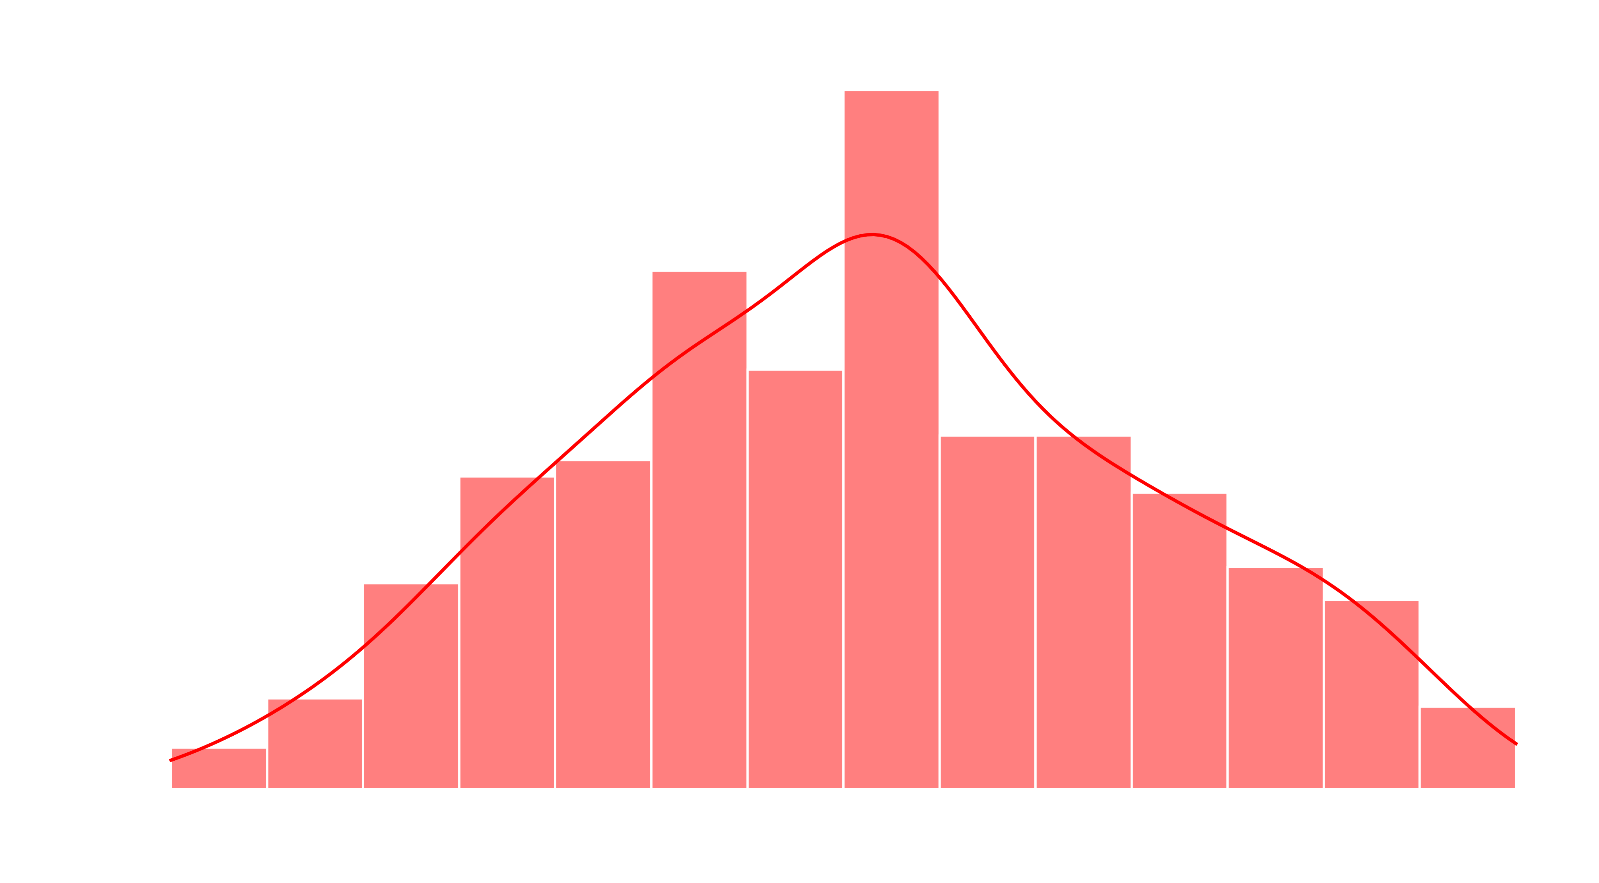
VISUALIZATIONS OF THE DATASET

Slide 12
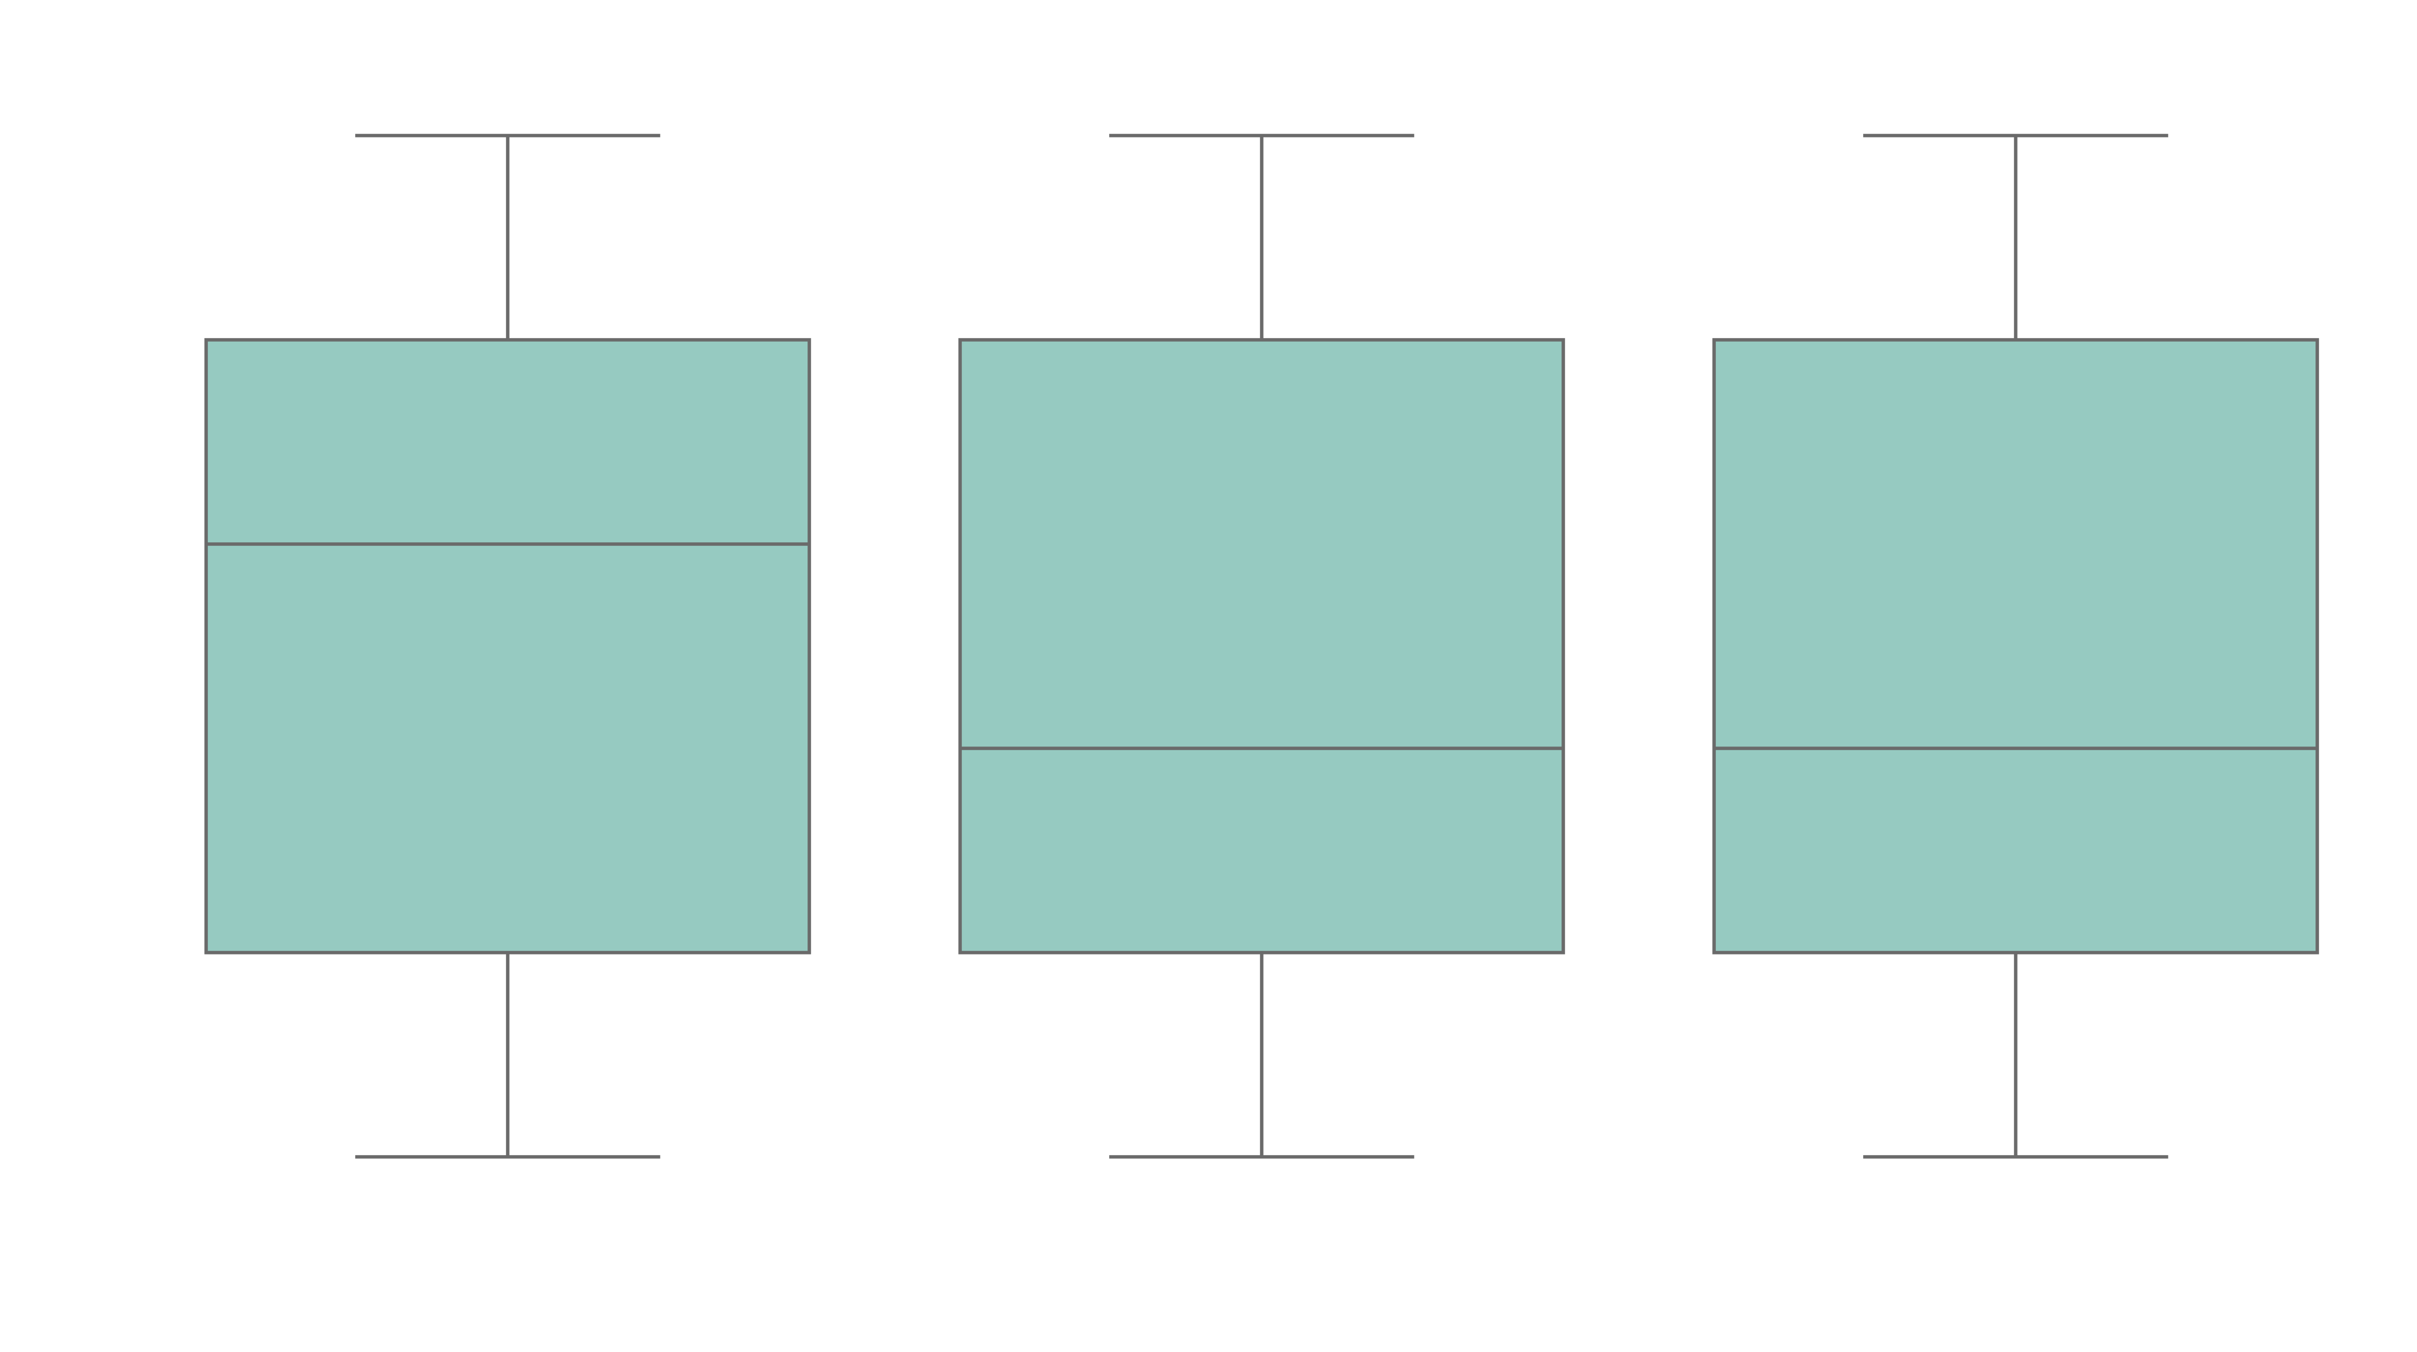
VISUALIZATIONS OF THE DATASET

Slide 13
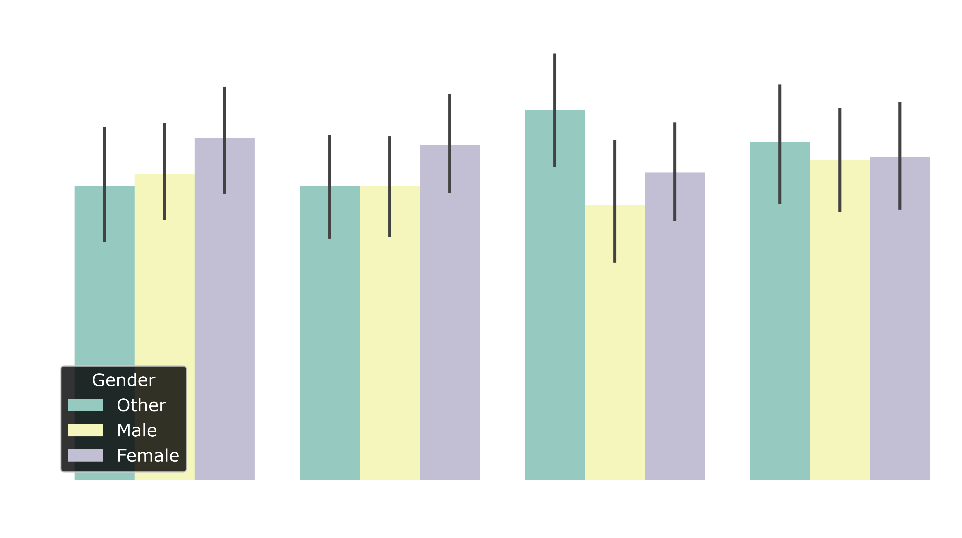
VISUALIZATIONS OF THE DATASET

Slide 14
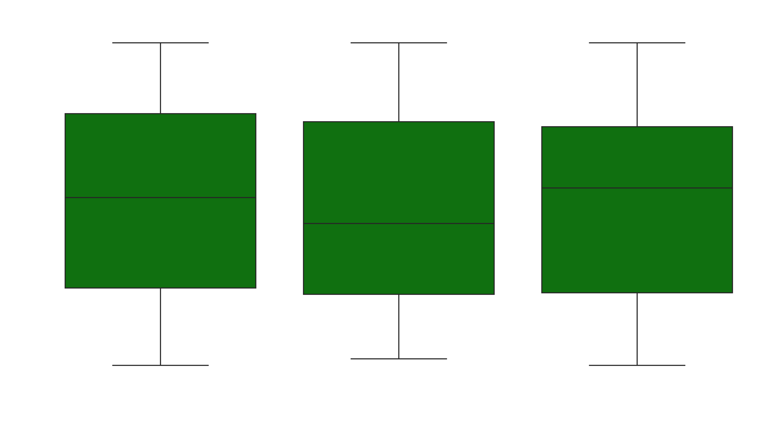
VISUALIZATIONS OF THE DATASET

Slide 15
VISUALIZATIONS OF THE DATASET

Slide 16
NEW TITLE

Slide 17
THANK YOU
:
D

